Slide 1

Artificial Intelligence
Lecture 5
By/ aly maher abdelfattah

Slide 2
Informed (Heuristic) Search Strategies
Greedy best-first search
A* search

Slide 3
Greedy best-first search
A heuristic function h(n) = estimated cost of the cheapest path from the state at node n to a goal state.
At each step, best-first search sorts the queue according to a heuristic function.
evaluation function 𝑓(𝑛) = ℎ(𝑛)

Slide 4
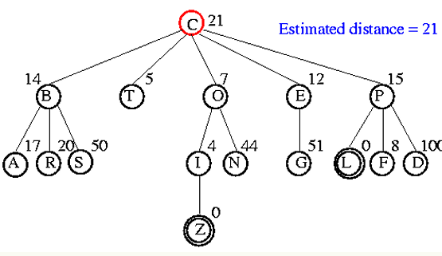
Greedy best-first search

Slide 5
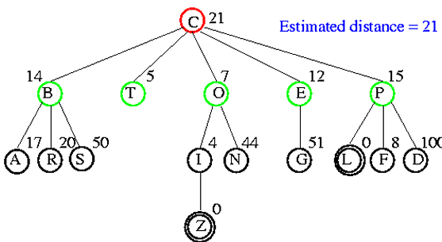
Greedy best-first search

Slide 6
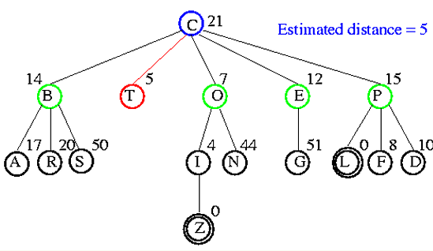
Greedy best-first search

Slide 7
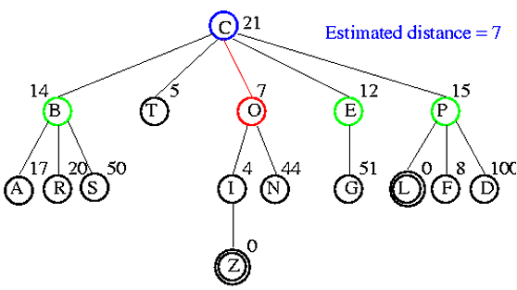
Greedy best-first search

Slide 8
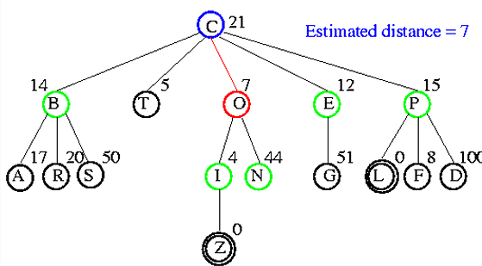
Greedy best-first search

Slide 9
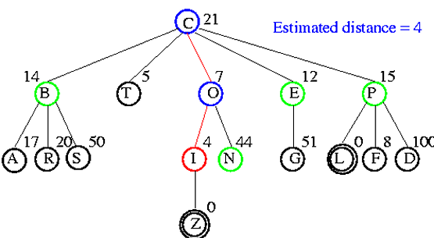
Greedy best-first search

Slide 10
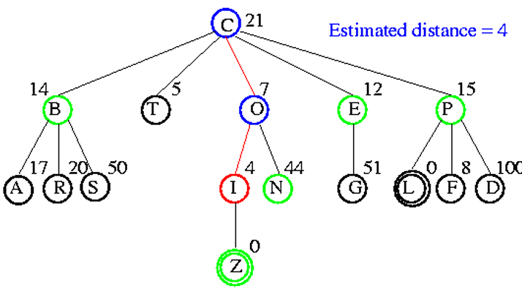
Greedy best-first search

Slide 11
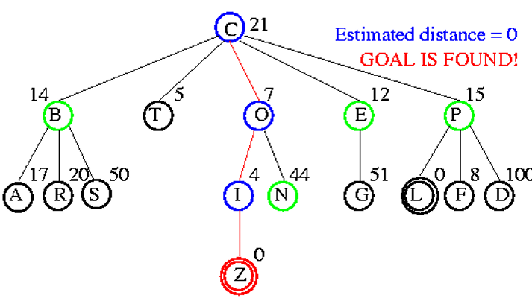
Greedy best-first search

Slide 12
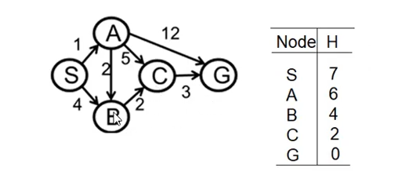
A* search
Definitions:
Assume the following path: S => A => C:
G-cost = the cost to move from S to A to C (G-cost = 1+5=6)
H-cost = the H value fir the last node in the path (C) from the given table (H-cost = 2)
F-cost = G-cost + H-cost = 6+2 = 8

Slide 13
A* search
Solution idea:
Use a priority queue (like uniform-cost search)
Pop the element with least F-cost
If two elements have the same F-cost, use alphabetic order
Remember: if a node is already visited we don’t expand it again

Slide 14
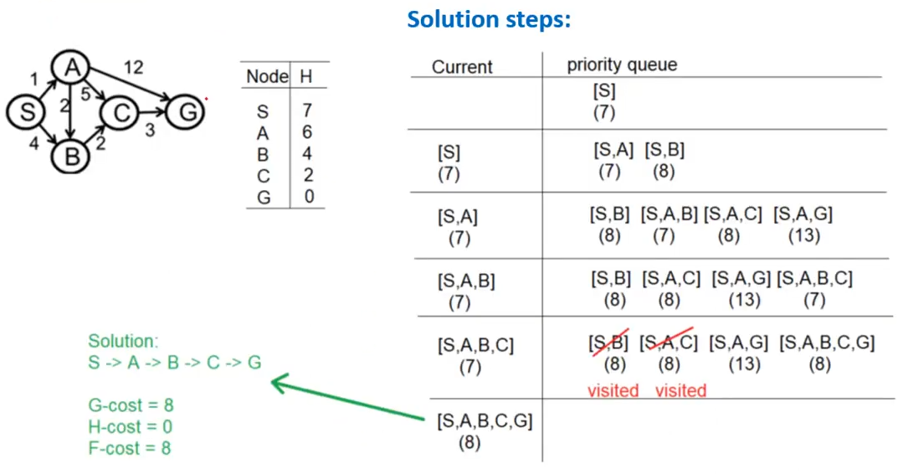
A* search

Slide 15

Thank you

